Slide 1
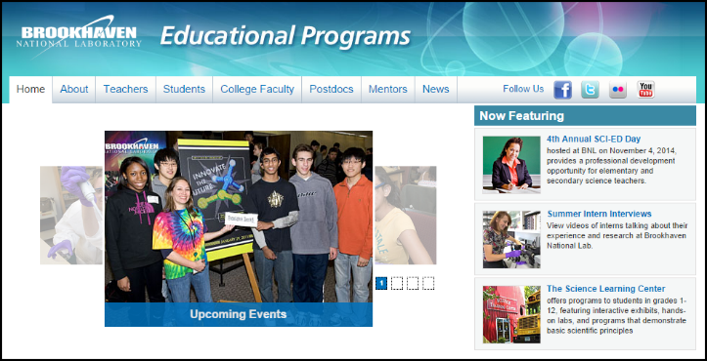
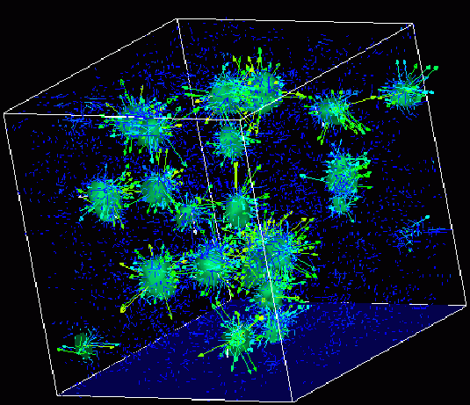

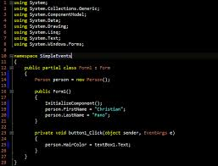
Survey of
Scientific Computing
(SciComp)
Unit 1
Remote Access

Slide 2
Goals
Access your remote PC in Amazon’s cloud
Learning and Practicing commands in the terminal
Learning to restart the remote PC

Slide 3
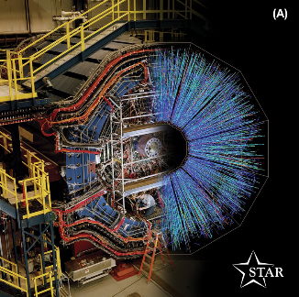
Scientific Computing in the Cloud
The cloud is a great equalizer
Allows participants to continue learning at home as on campus
Cloud machines are fully isolated from school networks - eliminates local software installation restrictions & campus cybersecurity concerns
Schools with low-end PC labs can still access thenewest generation of hardware

Slide 4
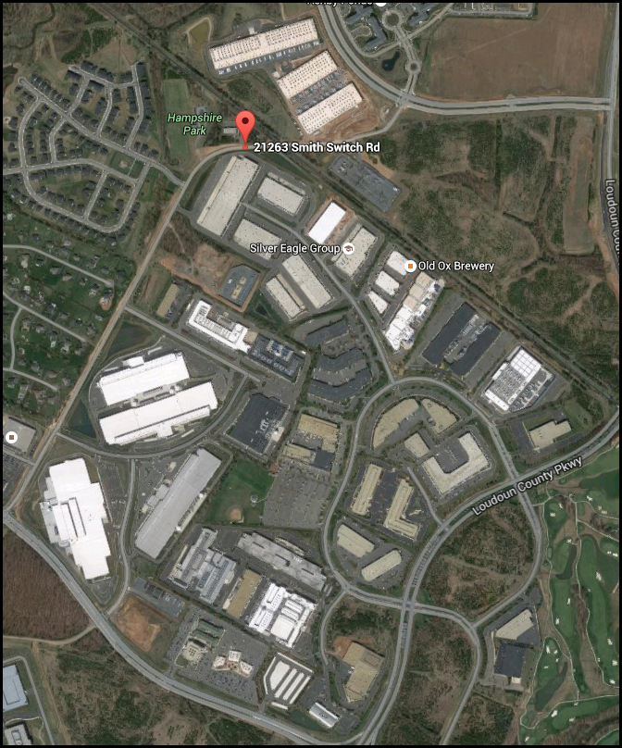
Amazon’s
23 data centers in Ashburn, Virginia

Slide 5
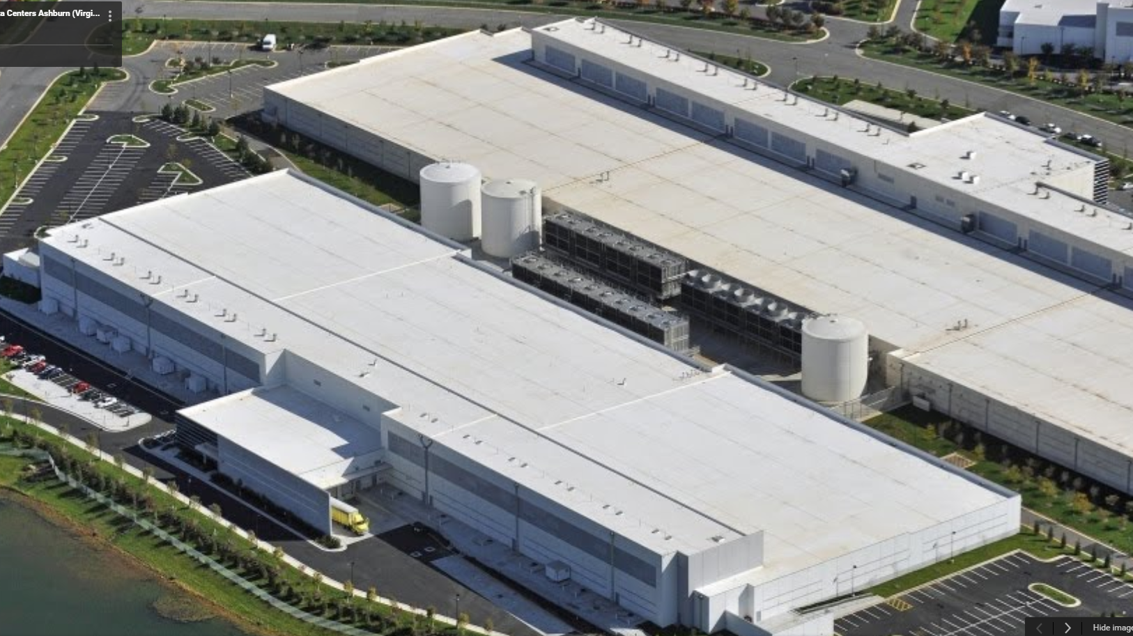
Just two of Amazon’s 23 cloud
data centers in Ashburn, Virginia

Slide 6
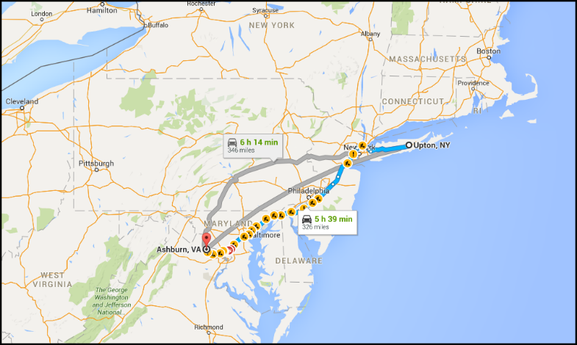
BNL ↔ Ashburn
Roundtrip = 660 miles

Slide 7
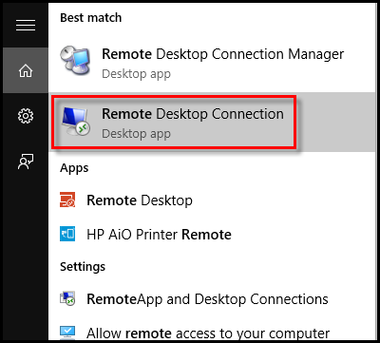
Accessing an Amazon Remote PC
Uses Microsoft’s “Remote Desktop Connection” application
Students have assigned credentials
The IP address (computer name) of their specific machine in Amazon’s cloud
Their user name (case sensitive!)
Their password (case sensitive!)
Students can access their Amazon machine from their home
Educators can remotely monitor student progress real-time on the lab exercises

Slide 8

Accessing an Amazon Remote PC
Write down your IP address, username, and password in your notebook
Take a picture of your login information to keep on your smart phone

Slide 9
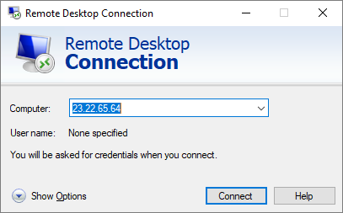
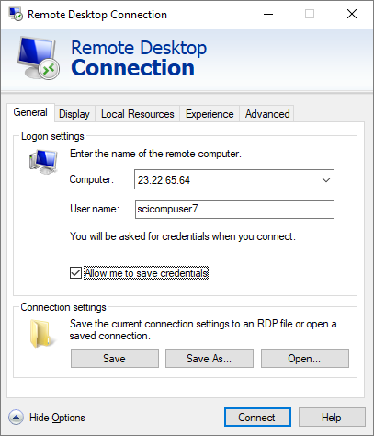
Accessing an Amazon Remote PC
Enter your IP address
Enter your username
Click on
“Show Options”
Click on
“Connect”
Click on
“Save Credentials”

Slide 10
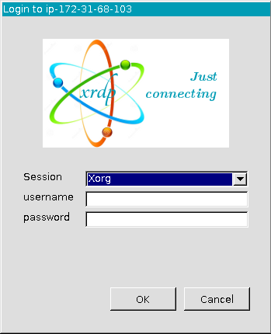
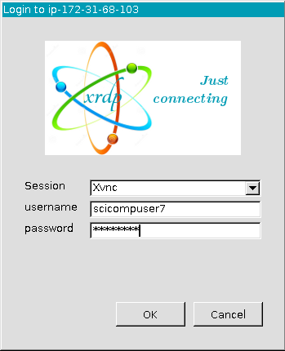
Accessing an Amazon Remote PC
Enter your username
Drop down and select “Xvnc”
Enter your password
Click “OK”

Slide 11
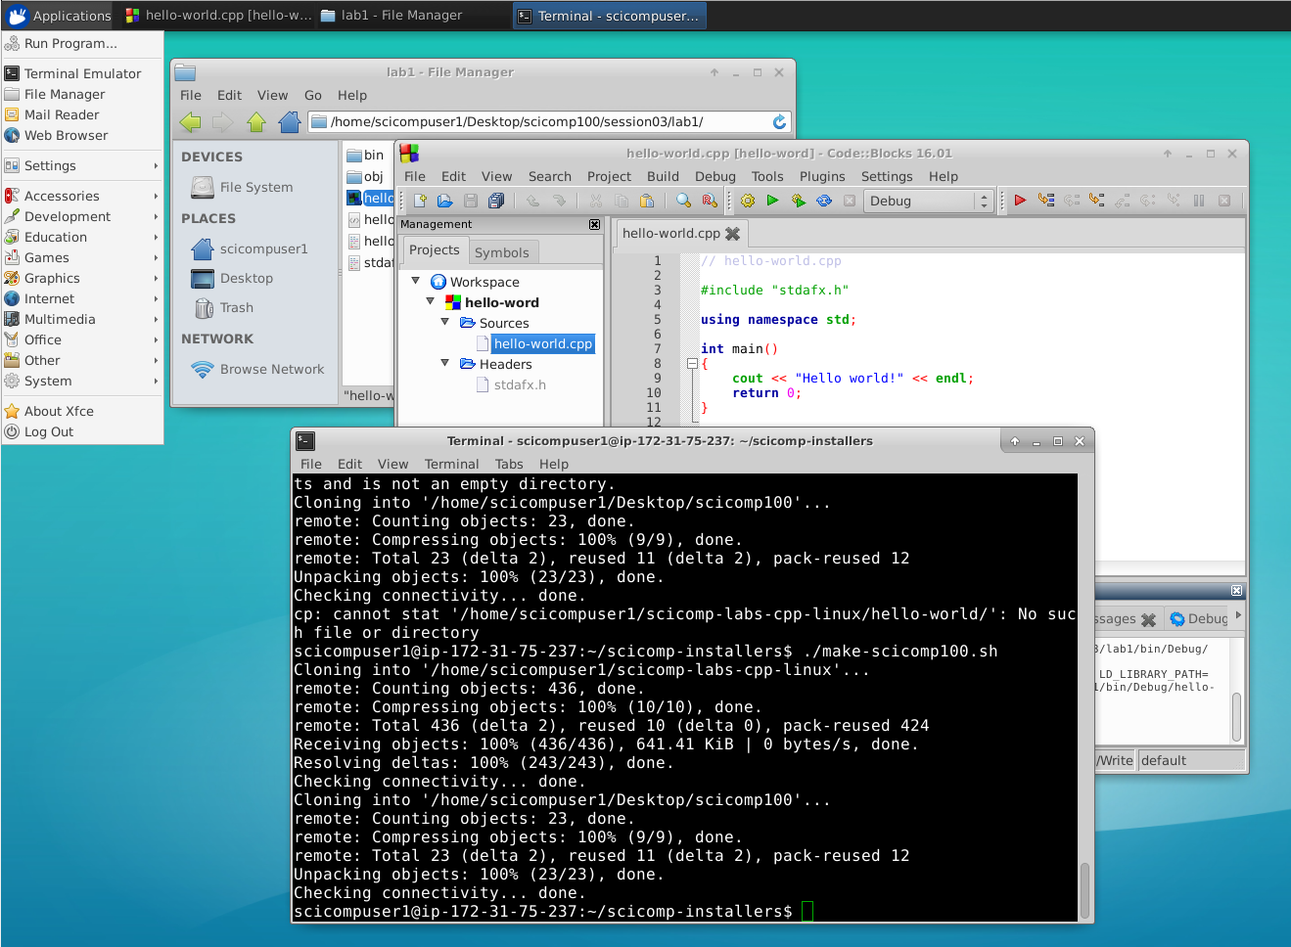
Ubuntu Linux with Xfce Desktop
The “Start” button is at the top-left of the desktop

Slide 12
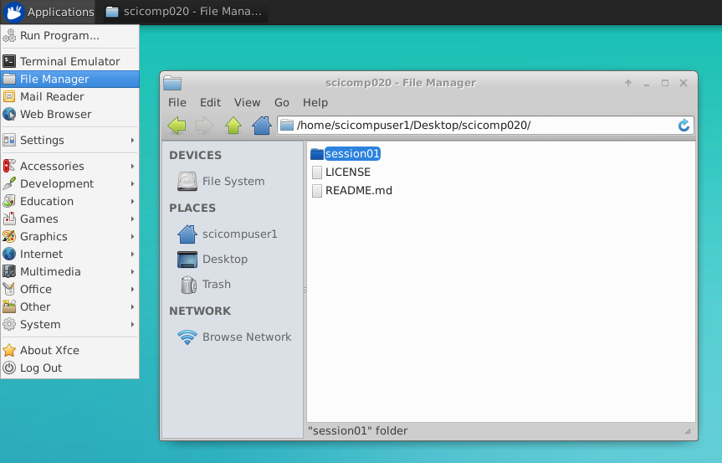
Ubuntu Linux with Xfce Desktop
The File Manager
works like
Windows Explorer or
Apple Finder

Slide 13
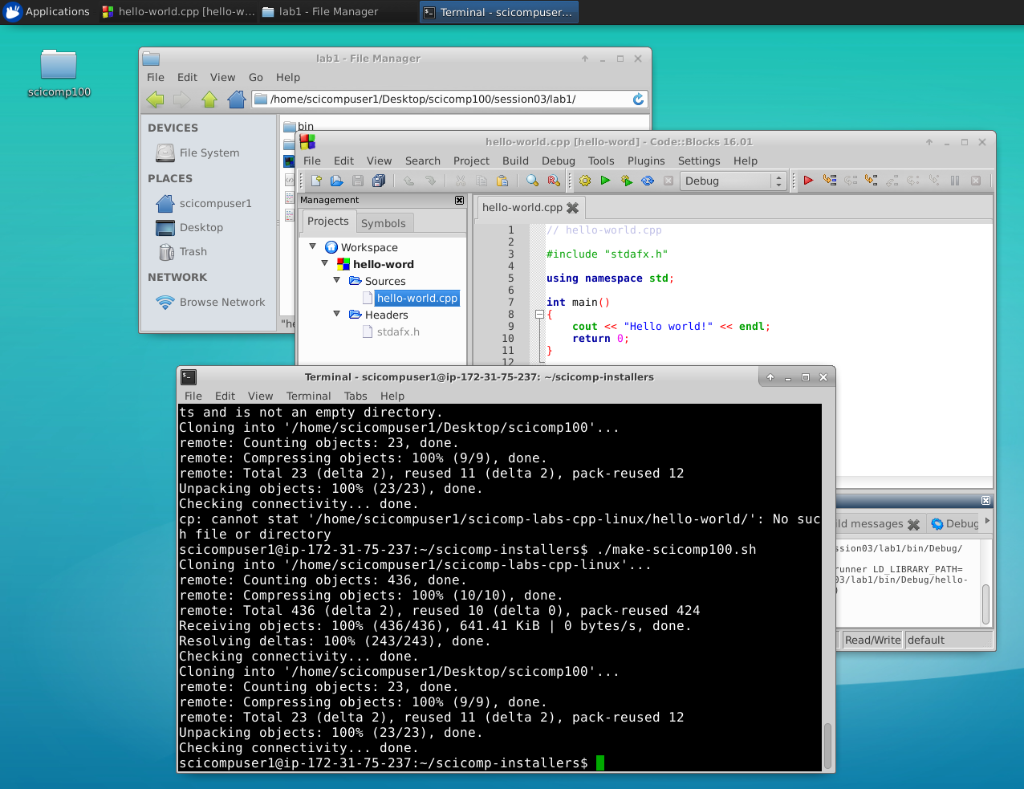
Ubuntu Linux with Xfce Desktop
Windows can be minimized, maximized or closed using these buttons

Slide 14
Ubuntu Linux with Xfce Desktop
Windows can be moved by left-click & dragging their title bar

Slide 15
Ubuntu Linux with Xfce Desktop
Open windows and apps appear in the task bar at the top of the desktop

Slide 16
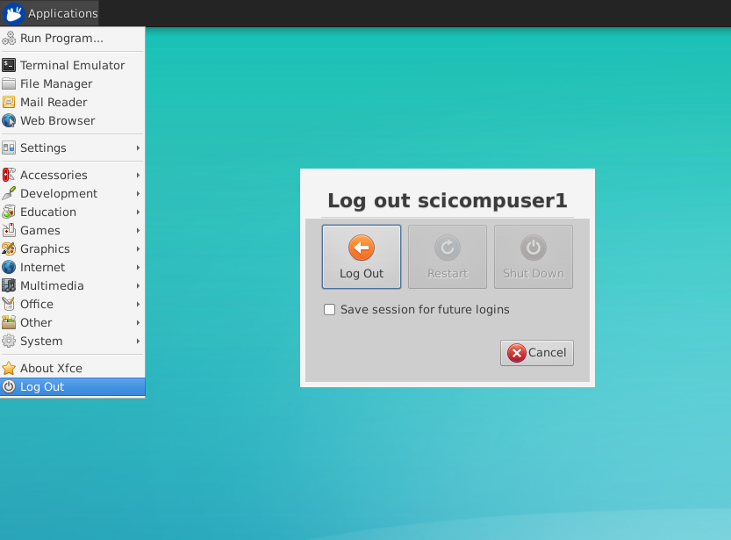
Ubuntu Linux with Xfce Desktop
Use the “Applications…Log Out” button to exit your Amazon PC

Slide 17
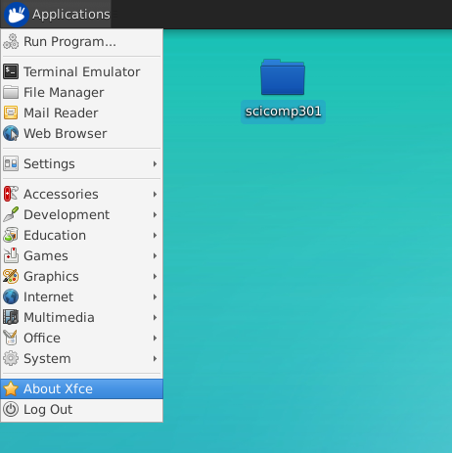
SciComp Courseware Layout
All of the courseware is in this folder on your Amazon Desktop
Ubuntu 16.04 LTS (64-Bit)
Xfce 4.0 Desktop

Slide 18
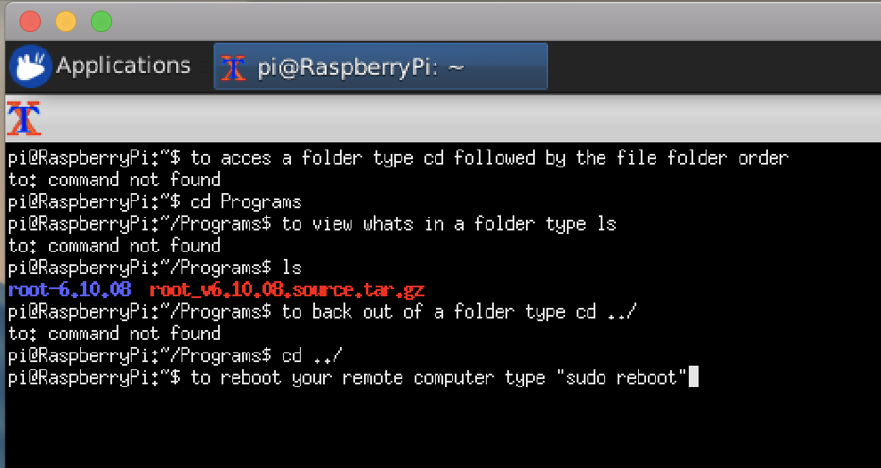
Explore Terminal

Slide 19
Now you know…
How to access your remote Amazon PC
Linux with Xfce is quite similar to Microsoft Windows
How to log out of your Linux (Ubuntu) desktop session

